Slide 1

2016 Database Management & Modeling Group Project
Bingxu Huang Peilu Liu
Lingxiang Wen Xiaoxiao Liu

Slide 2

Entertainment Inc.
2016 Database Management Group Project
Loyalty Program (Frequency Upside )
Retention Program
The Total Rewards Program
What are the objectives of the various Database marketing programs and are they working?

Slide 3
Entertainment Inc.
2016 Database Management Group Project
Loyalty Program (Frequency Upside )
Retention Program
The Total Rewards Program
Database Marketing Programs:
New Business Program
Loyalty Program:
Frequency Upside
Budget Upside
Retention Program
The Total Rewards Program

Slide 4
Entertainment Inc.
2016 Database Management Group Project
Database Marketing Programs
New Business Program
Loyalty Program
Retention Program
The Total Rewards Program
New Business Program

Slide 5
Entertainment Inc.
2016 Database Management Group Project
Database Marketing Programs
New Business Program
Loyalty Program
Retention Program
The Total Rewards Program
Objectives: Improve the effectiveness at converting new Total Gold members into loyal customers.
How It Works:
Analyze customers based on a combination of theoretical wins and observed results
Find new opportunities in new segmented groups
Send personalized offers to targeted customers
Reduce unnecessary offers
Results:
Succeed in market
In general, almost half of the customers returned (response rate is 46%)
A promising future
Increasing response rate
After the first round of redemption, the response rate is around 50%

Slide 6
Entertainment Inc.
2016 Database Management Group Project
Database Marketing Programs
New Business Program
Loyalty Program
Retention Program
The Total Rewards Program
Succeed in revenues
Incremental gains are increasing and above if we use the first month`s revennues as a benchmark.
Returning customers generate more revenues than new registered customers.
Total revenues increased from 1998 to 1999

Slide 7
Entertainment Inc.
2016 Database Management Group Project
Database Marketing Programs
New Business Program
Loyalty Program
Retention Program
The Total Rewards Program
Loyalty Program
(Frequency Upside and Budget Upside)

Slide 8
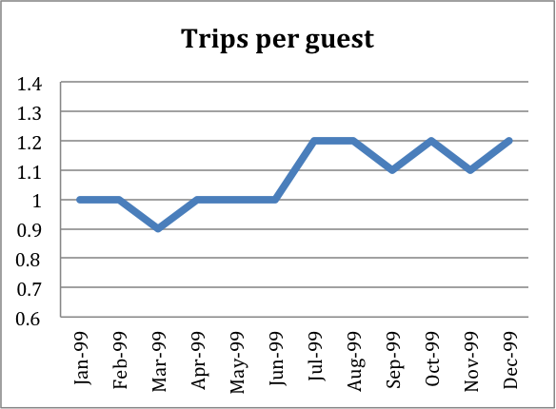
Entertainment Inc.
2016 Database Management Group Project
Database Marketing Programs
Loyalty Program (Frequency Upside )
New Business Program
Retention Program
The Total Rewards Program
Objectives: increase customers’ trip frequency to Harrah’s, and then check whether increasing frequency can bring more revenue for the company.
How It Works:
Identified a group of customers.
sent an offer to the group.
The offer can be redeemed in next three months.
Result of the Program:
the trips per guest is stable on 1 before June 99
increase to about 1.2 after June

Slide 9
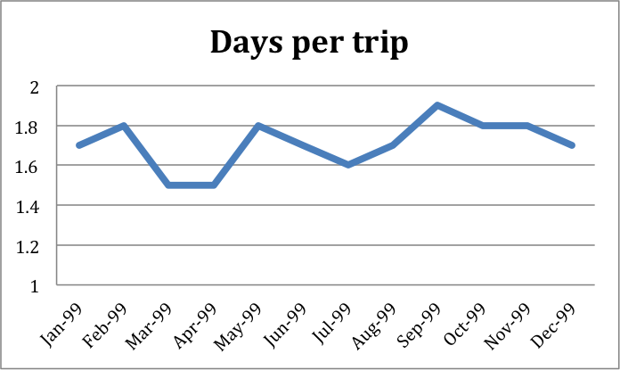
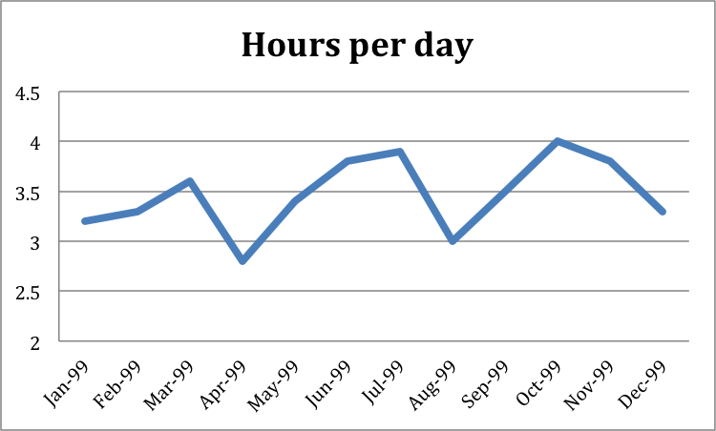
Entertainment Inc.
2016 Database Management Group Project
Database Marketing Programs
Loyalty Program (Frequency Upside )
New Business Program
Retention Program
The Total Rewards Program
The difference between before June 99 and after June 99 is small
1.5 to 1.8 before June, and1.6 to 1.9 after June.
A seasonal cycle of rise and fall
The result of hours per day is very similar with the result of days per trip.
a seasonal cycle of rise and fall
The hours are stale between 3 hours and 4 hours

Slide 10
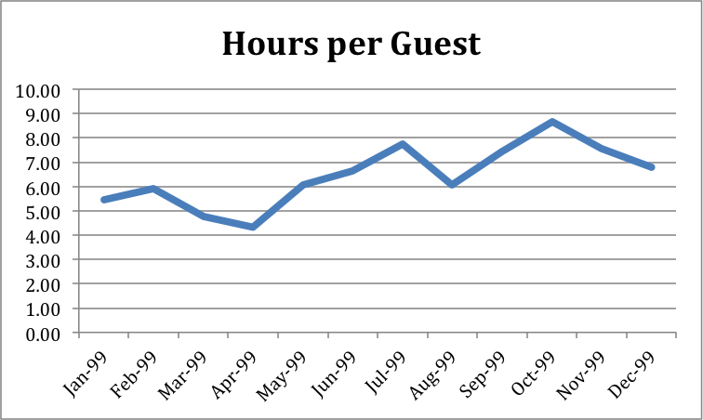
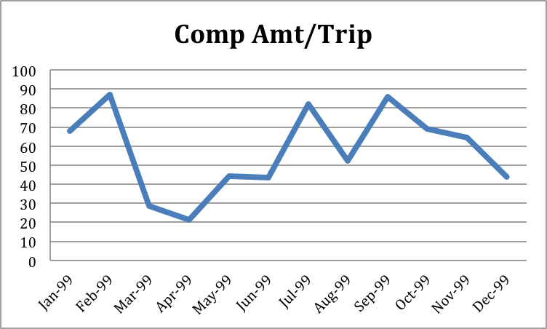
Entertainment Inc.
2016 Database Management Group Project
Database Marketing Programs
Loyalty Program (Frequency Upside )
New Business Program
Retention Program
The Total Rewards Program
Equal to hours/trips* trips per guest.
The hours that a customer spent in the casino increased obviously.
Changed from 4 to 6 hours to 6 to 8 hours.
Provided more complimentary dollar to sample customer after they accepted the offers.
more customers redeemed offers in first three months.

Slide 11
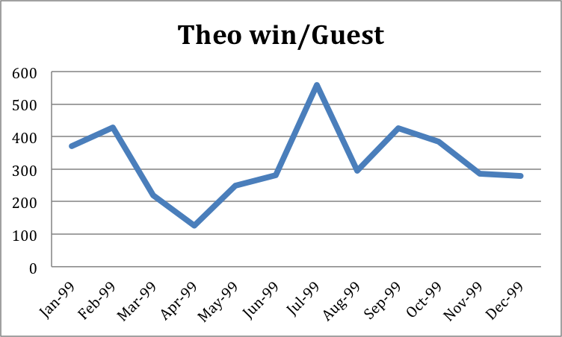
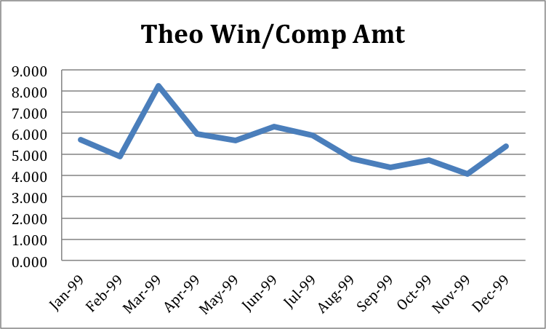
Entertainment Inc.
2016 Database Management Group Project
Database Marketing Programs
Loyalty Program (Frequency Upside )
New Business Program
Retention Program
The Total Rewards Program
Theo win from each sample customer will increase after they accept the offers.
Customers prefer to spend more money in Harrah’s casinos.
The revenue that each complimentary dollar can generate decreased after customers accepted offer.
the performance of each complimentary dollar spending is less efficient.

Slide 12
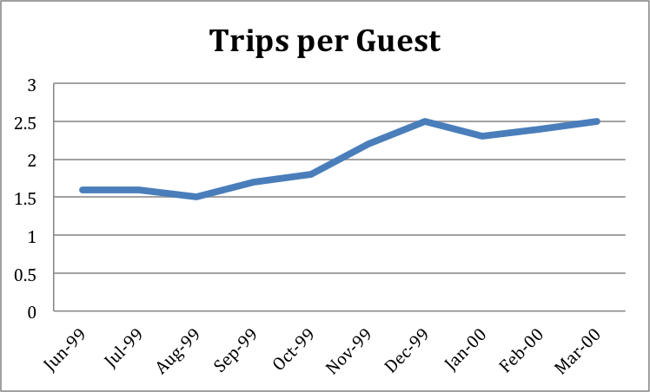
Entertainment Inc.
2016 Database Management Group Project
Database Marketing Programs
New Business Program
Loyalty Program (Budget Upside )
Retention Program
The Total Rewards Program
Objectives: encourage the customer to visit Harrah’s first and thereby capture the majority of the single casino trips.
How It Works:
Chose a sample group of people that it thought they had an upside budget potential.
mailed offers in October and could be redeemed in November, December and January.
In January, these sample customers would be re-evaluated again.
an additional offers would be send again to capture maximum potential budget in February and March.
Before the offer sending (October 99), the frequency that customers visit casinos is stable from 1.5 to 1.7.
this number jumps to 2.2 to 2.5 after the offers sending
is very useful on increasing customers’ frequency of trips.

Slide 13
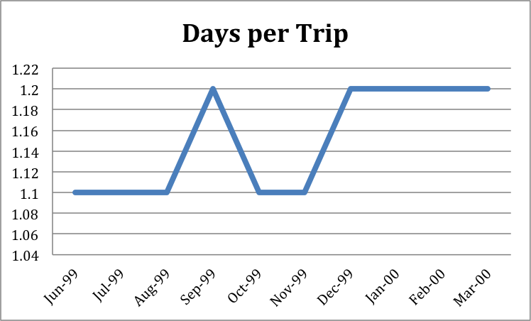
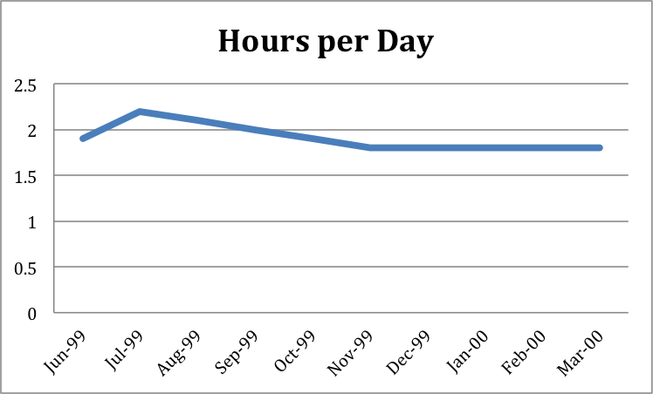
Entertainment Inc.
2016 Database Management Group Project
Database Marketing Programs
New Business Program
Loyalty Program (Budget Upside )
Retention Program
The Total Rewards Program
For days per trip, the effect of this program is not very significant.
The days per trip is fluctuating in a range from 1.1 to 1.2.
On hours per day, the trend of changing is decreasing, but the is still not very significant.
The range is from 1.8 to 2.1.

Slide 14
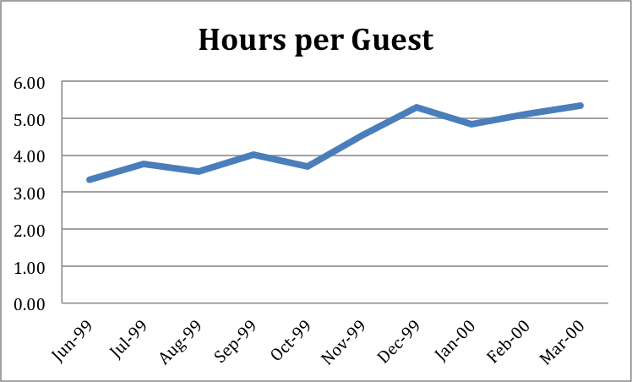
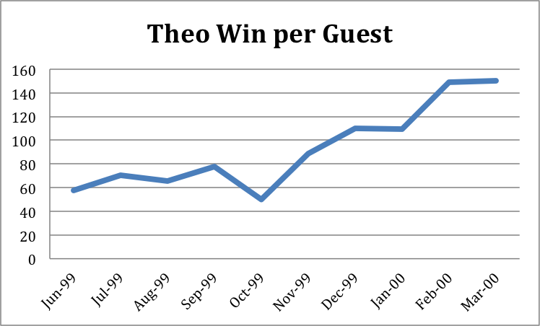
Entertainment Inc.
2016 Database Management Group Project
Database Marketing Programs
New Business Program
Loyalty Program (Budget Upside )
Retention Program
The Total Rewards Program
Equal to hours/trips* trips per guest.
The effect of this program on hours per guest is very significant.
Can significantly increase customers’ budget in Harrah’s casinos.
Before offers sending (October 99), the theo win per guest is stable from $60 to $80.
After offers sending, this number increases above $100 (a range from $110 to $150).

Slide 15
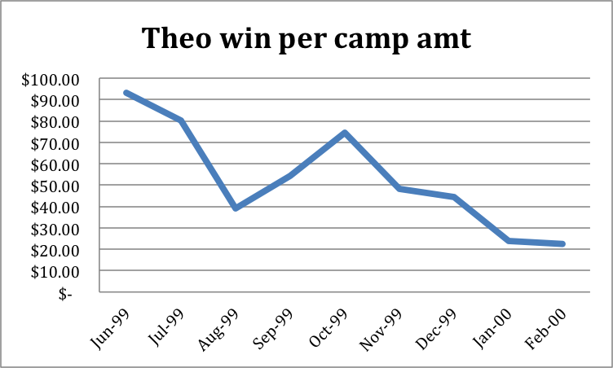
Entertainment Inc.
2016 Database Management Group Project
Database Marketing Programs
New Business Program
Loyalty Program (Budget Upside )
Retention Program
The Total Rewards Program
the efficiency of each complementary dollar is decreasing.
Before order sending, each complimentary can generate an average revenue about $90.
This number decreases to $42 after offer sending.

Slide 16
Entertainment Inc.
2016 Database Management Group Project
Database Marketing Programs
New Business Program
Loyalty Program
Retention Program
The Total Rewards Program
Retention Program

Slide 17
Entertainment Inc.
2016 Database Management Group Project
Database Marketing Programs
New Business Program
Loyalty Program
Retention Program
The Total Rewards Program
Objective:
To retain two kinds of customers:
Customers who had broken their historical visitation pattern;
Customers who had attired their relationships with Harrah.
How it works?
Using DBM
Divided their customers into different segments;
Tested customers’ response rates by sending them different promotions;
Identify the real loyal guests, and the proper activities.
Working with local property
Educated local managers and their teams;
Combined DBM with local marketing insight;
Designed and used proper DBM system to achieve their goals.

Slide 18
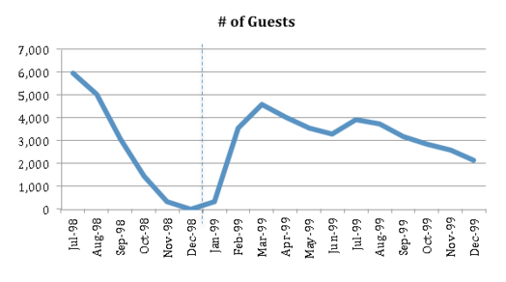
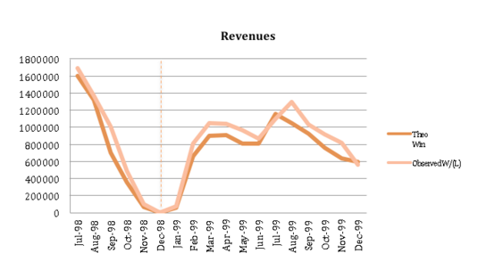
Entertainment Inc.
2016 Database Management Group Project
Database Marketing Programs
New Business Program
Loyalty Program (Frequency Upside )
Retention Program
The Total Rewards Program
Result:
Before January 1999, the number of customer, theoretical wins, observation wins and the composition of customer who used mail offer declined dramatically.
After that, the number of guests, theoretic wins and observation wins increased a lot.
However, these numbers decreased a little bit by the end of 1999. This might because of the effects of situation, different time period of a year and the increase of cost.

Slide 19
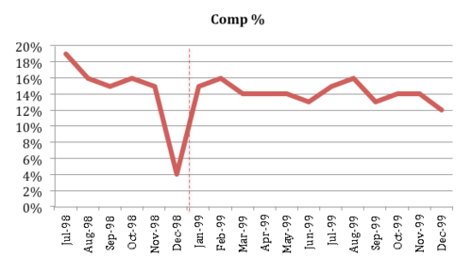
Entertainment Inc.
2016 Database Management Group Project
Database Marketing Programs
New Business Program
Loyalty Program (Frequency Upside )
Retention Program
The Total Rewards Program
Result:
The composition rate of customer who used mark offer went back the pervious in January 1999, and kept flat in the following months.
This shows that sending different offers to different segments really worked.
Thus, the retention program worked.
Suggestion: If the company wanted a better revenue, they should also focus on offering different offers based on different time of a year and decreasing cost.

Slide 20
Entertainment Inc.
2016 Database Management Group Project
Database Marketing Programs
New Business Program
Loyalty Program
Retention Program
The Total Rewards Program
The Total Rewards Program

Slide 21
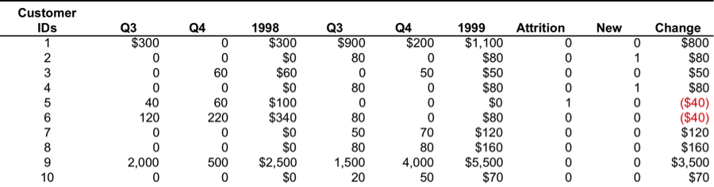
Entertainment Inc.
2016 Database Management Group Project
Database Marketing Programs
New Business Program
Loyalty Program
Retention Program
The Total Rewards Program
Objective: consolidate plays and improve loyalty.
How It Works:
Provides a Rewards Menu that translates rewards credits to various offerings.
Added two additional tier levels - Total Gold and Total Platinum.
Changed common cards to colored plastic cards
Total reward program was released in July 1999.
Eliminate the results of Q1 and Q2 in 1998 and 1999.
Calculate the change between Q3&Q4 in 1998 and Q3&Q4 in 1999.

Slide 22
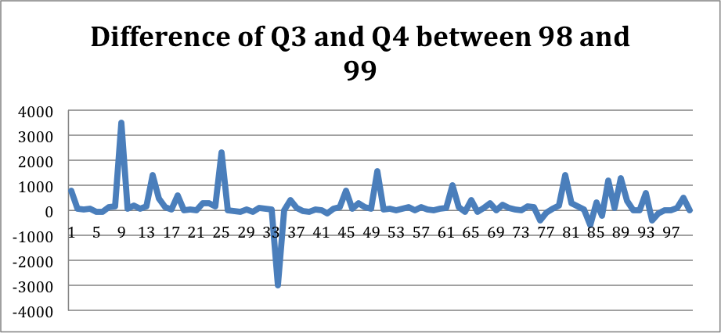
Entertainment Inc.
2016 Database Management Group Project
Database Marketing Programs
New Business Program
Loyalty Program
Retention Program
The Total Rewards Program
Helped Harrah’s increase its market share from 7.1% in 1998 to 9.7% in 1999.
A value in the line chart is positive, it means that this customer has more theo win value in 1999 rather than in 1998.
Most sample customers have positive values, and a few of them have negative values.
The sample that just has 100 customers of this test is a little small.

Slide 23
Entertainment Inc.
2016 Database Management Group Project
Loyalty Program (Frequency Upside )
Retention Program
The Total Rewards Program
2. Why is it important to use the “customer worth” in the DBM efforts rather than the observed level of play?

Slide 24
Entertainment Inc.
2016 Database Management Group Project
Loyalty Program (Frequency Upside )
Retention Program
The Total Rewards Program
More Accurate: target/strategy
Accuracy：to use “customer worth” in DBM rather than to use observed level.
The quantitative models can accurately predict “customer real worth”;
Now: The house expects to win over a long term-CLV;
Past: Observed play-Short term value;
Enable the company build relationships with customers based on their future worth, rather than on their past behavior.
Notes:
This can help the hotel expand more accurate target customer base, and accurately find those potential customers who could not have shown up on the radar screen using observed level.

Slide 25
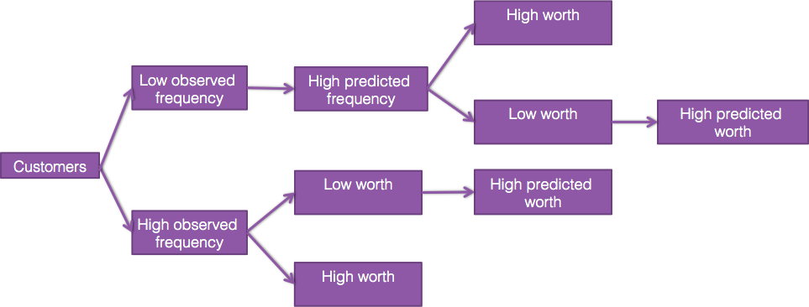
Entertainment Inc.
2016 Database Management Group Project
More opportunity
Quantitative model: a more accurate segmentation.
Using the information for each customer, Harrah’s is able to predict potential customer playing behavior.
Customers are first segmented by observed frequency;
Low observed frequency, customers are further segmented by predicted frequency;
High-observed frequency group are segmented based on their existing worth;
In the sub-segmented groups, customers are further analyzed by their predicted worth if they do not show a high observed frequency or high worth.
Loyalty Program (Frequency Upside )
Retention Program
The Total Rewards Program

Slide 26
Entertainment Inc.
2016 Database Management Group Project
Loyalty Program (Frequency Upside )
Retention Program
The Total Rewards Program
Decreased costs: marketing experiment
“Marketing experiments”
Right marketing instrument
Right behavior modification
Right customer
Direct marketing

Slide 27
Entertainment Inc.
2016 Database Management Group Project
Increase customer value
To Harrah’s, customer lifetime value is measurable
Direct marketing
Database system
Increase customer value by increasing revenue and by decreasing cost
Increase Revenue:
Increasing visiting frequency and customers budgets;
Changing customers to loyalty customers;
reactivating previous customers
Decrease cost:
Sending accurate promotions to different segments;
All of these programs are based on one thing——have a clear customer segment, and this need a clear definition of customer worth.
Loyalty Program (Frequency Upside )
Retention Program
The Total Rewards Program

Slide 28
Entertainment Inc.
2016 Database Management Group Project
New Business Program
Loyalty Program
Retention Program
The Total Rewards Program
3. How does Harrah’s integrate the various elements of its marketing strategy to deliver more than the results of Database Marketing?

Slide 29
Entertainment Inc.
2016 Database Management Group Project
Customer Loyalty is the Core Competency
People
Strategy
Middle1990s
Grow Business In
a Limited Market
Customer
Loyalty
Early 1990s
New Market
Emerging Competitors
Winner`s Information Network
Not Work

Slide 30

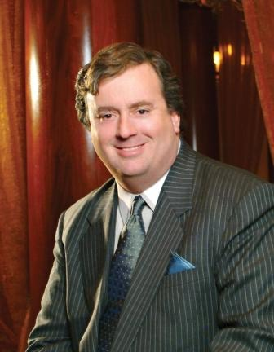
Entertainment Inc.
2016 Database Management Group Project
An Integrated Solution
Build a Centralized Database
Centralized Management
The Total Gold
/Rewards
Program
Brand Differentiation
Distinguished Service
Relationship Marketing
Database Marketing
Recruit a COO who have
an insight based on a solid
understanding of data

Slide 31
Entertainment Inc.
2016 Database Management Group Project
The Total Gold Program
Integrated Information System
Built a completely integrated
information technology
network which linked all the
properties together and was
able to share information in
real time across various
properties.
Cross market revenues
increased by 10%
from 1997 to 2000

Slide 32
Entertainment Inc.
2016 Database Management Group Project
The Total Rewards Program
Rewards Menu
The rewards menu
translates rewards
credits to various
offerings
Results
Colored Plastic Cards
Total Rewards Program to create
real loyalty by creating reward
menu that translates credits to
various complimentary offerings
and creating tier levels.
Emotional
Bonds
Tiered Levels
Building emotional
bonds to reduce the
negative side effects
resulting from privacy problems.
Total Gold
Total Platinum

Slide 33
Entertainment Inc.
2016 Database Management Group Project
Other Marketing Strategies
Centralized Management
Integrated Information System
Integrated Information System
Division presidents and
subordinates report
to COO
Creating key
differentiator based on
marketing research.
Conveying the message
of “ Exuberantly alive” to
customers by heavy
advertisement
investment
Providing more than
good service, which is
distinguished service by
a variety of interventions
at the employee level:
service process
designing, reward and
recognition,
measurement of
executives.

Slide 34
Entertainment Inc.
2016 Database Management Group Project
Implementing Marketing Tools
Opportunity Based Segmentation
Experimented Marketing
Relationship
Marketing
Database
Marketing

Slide 35
Entertainment Inc.
2016 Database Management Group Project
New Business Program
Loyalty Program
Retention Program
The Total Rewards Program
4. What is the sustainability of Harrah’s actions and strategy?

Slide 36

Entertainment Inc.
2016 Database Management Group Project
“credit” from Total Gold program
can prevent customers from changing to competitors
Loyalty Program (Frequency Upside )
The Total Rewards Program
Total Gold
Total Platinum
Total Diamond
Encourage customers to become loyal

Slide 37



Entertainment Inc.
2016 Database Management Group Project
“credit” from Total Gold program
can prevent customers from changing to competitors
Loyalty Program (Frequency Upside )
The Total Rewards Program
Credits

Slide 38

Entertainment Inc.
2016 Database Management Group Project
creating meaningful brand differentiation
Loyalty Program (Frequency Upside )
The Total Rewards Program
Best service in this industry
Focus on gambling
“Thank You” e-mail

Slide 39

Entertainment Inc.
2016 Database Management Group Project
Loyalty Program (Frequency Upside )
The Total Rewards Program
core technology of Harrah’s database as well as their operating function was patented so as to bar Harrah’s competitors to copy

Slide 40
Entertainment Inc.
2016 Database Management Group Project
New Business Program
Loyalty Program
Retention Program
The Total Rewards Program
5. What are the privacy and ethical issues that Harrah’s should be concerned about?

Slide 41
Entertainment Inc.
2016 Database Management Group Project
Loyalty Program (Frequency Upside )
Retention Program
The Total Rewards Program
Moral Dilemma In the Gaming Industry
Marketing dilemma & regulation in gambling industry
The Safety of Customer Data
Gambling Advertising Regulations

Slide 42

Entertainment Inc.
2016 Database Management Group Project
Loyalty Program (Frequency Upside )
Young people protection
Retention Program
The Total Rewards Program

Slide 43

Entertainment Inc.
2016 Database Management Group Project
Gambling Does not Add Value To the World
The Dog Eat Dog Profit Mode
Loyalty Program (Frequency Upside )
Retention Program
The Total Rewards Program

